Slide 1
Manitoba Barley Yields Clustering
Lakshmi Kadali

Slide 2
PROBLEM STATEMENT
Can we find clusters of similar RMs for Barley yields in Manitoba?
Insurance and financing companies can set premiums
Better risk management

Slide 3
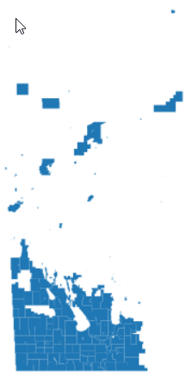
DATA COLLECTION & PREPROCESSING
Manitoba Crop Yields : https://www.masc.mb.ca/masc.nsf/mmpp_browser_soil_types.html
Geographical Boundaries of Manitoba Rural Municipalities: https://geoportal.gov.mb.ca/datasets/8b64285c3bf6445a8d0d8ea4a1c43849/explore?location=53.584348%2C-97.779011%2C6.81
Crop Yields from 2000-2022
11 crops : Alfalfa, Argentine Canola, Barley, Canary Seed, Durum Wheat, Faba Beans, Fields Peas, Flax, Lentils, Oats, Winter Wheat.
Pounds : Canary seed, Faba Bean, Lentils
Barley yield is in Bushels.
Dropped unnecessary columns

Slide 4
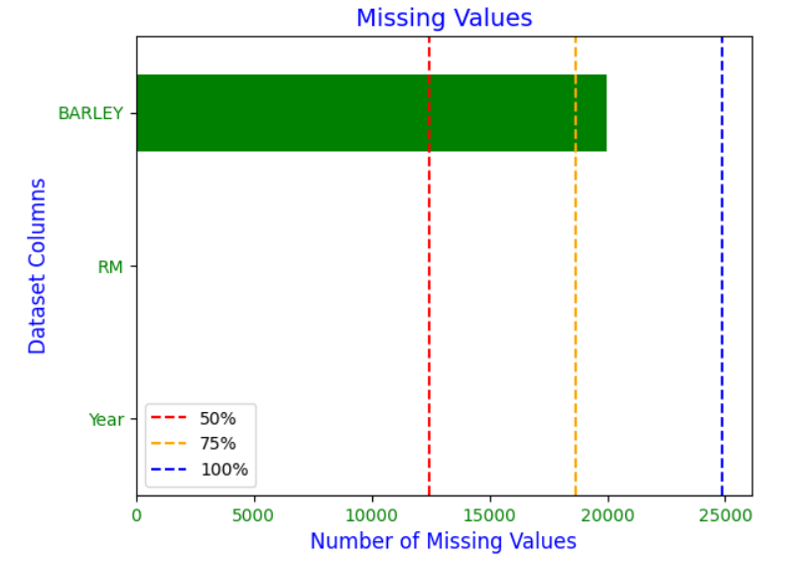
EXPLORATORY DATA ANALYSIS

Slide 5
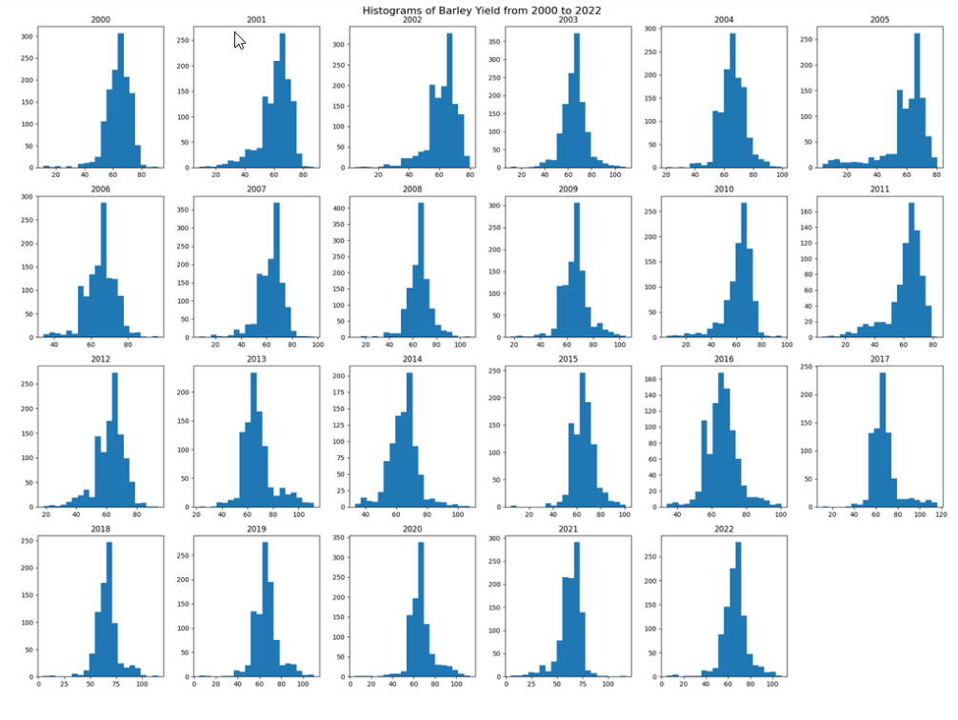
EXPLORATORY DATA ANALYSIS

Slide 6
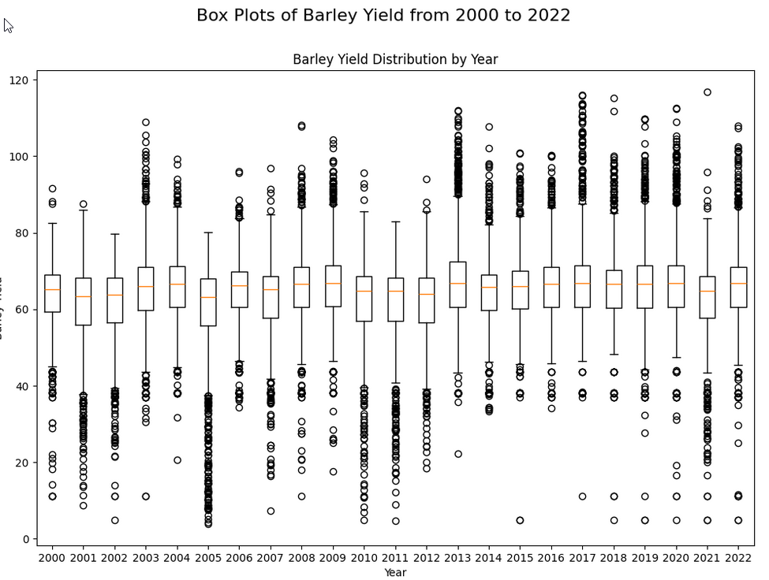
EXPLORATORY DATA ANALYSIS

Slide 7
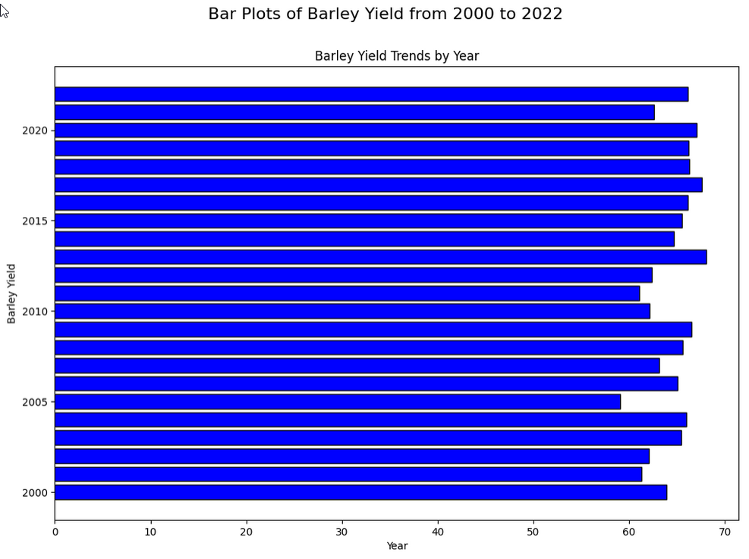
EXPLORATORY DATA ANALYSIS

Slide 8
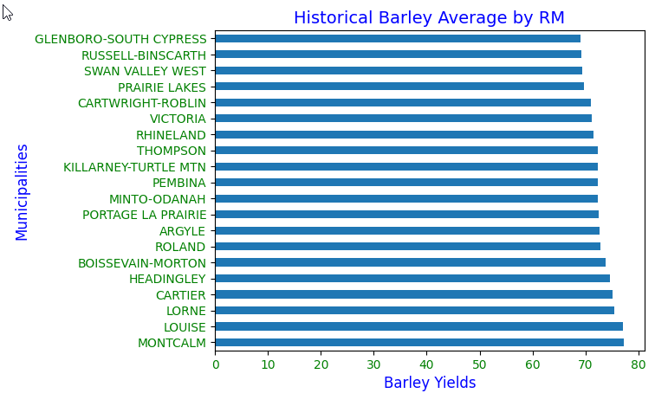
EXPLORATORY DATA ANALYSIS

Slide 9
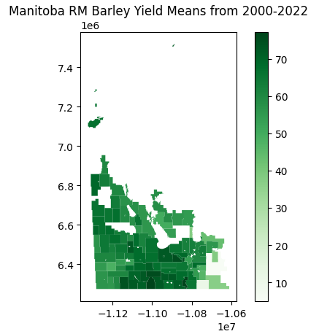
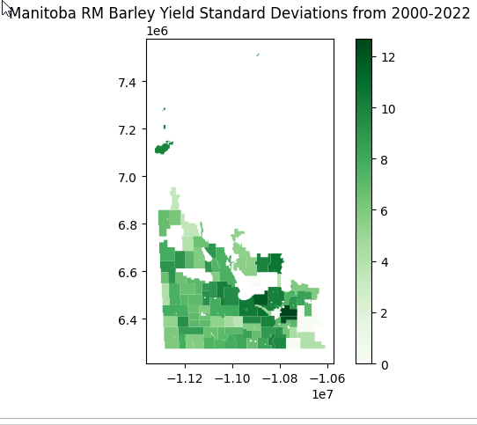
UNSUPERVISED MACHINE LEARNING : K-MEANS CLUSTERING

Slide 10
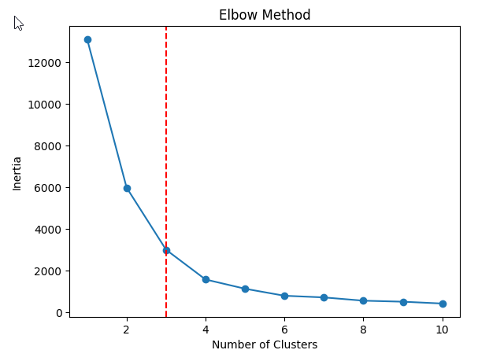
UNSUPERVISED MACHINE LEARNING : K-MEANS CLUSTERING

Slide 11
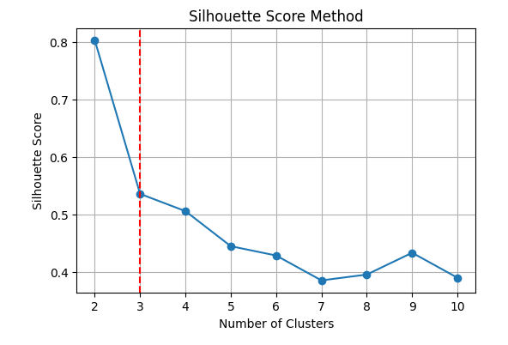
UNSUPERVISED MACHINE LEARNING : K-MEANS CLUSTERING

Slide 12
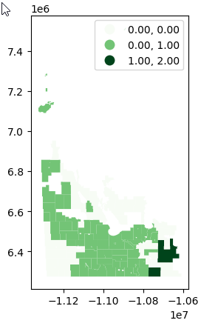
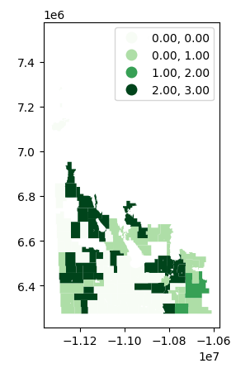
UNSUPERVISED MACHINE LEARNING : K-MEANS CLUSTERING

Slide 13
01
Interactive Dashboard for analyzing data in Manitoba’s rural municipalities.
RESULTS
https://public.tableau.com/views/ManitobaRMs-BarleyYieldsAnalysis/BarleyDashboard?:language=en-US&publish=yes&:sid=&:display_count=n&:origin=viz_share_link
02
03
Able to find 3 and 4 clusters of Barley yields in Manitoba RMs
Visualizations for Spatial map with color coding, Line chart with Barley yields, Bar chart to find Top RMs in Manitoba with historical Barley yields.
04

Slide 14
CONCLUSIONS & FUTURE WORK
It is possible to cluster Manitoba RMs based on Barley yield mean and standard deviation. Different clusters were created.
Spatial patterns of yields
Trend in data
Explore a similar approach to the soil type map of Manitoba.
Try DBSCAN for dissimilar RMs in Manitoba.

Slide 15
THANK YOU

